Slide 1



DIGITAL PORTFOLIO
By Ganta Rajesh
rajeshg0905@gmail.com

Slide 2
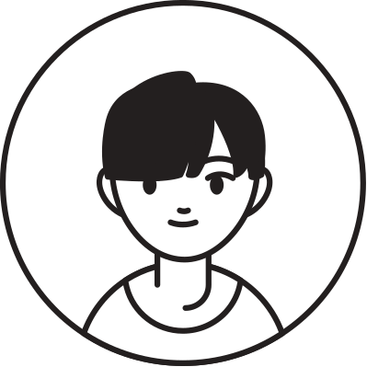
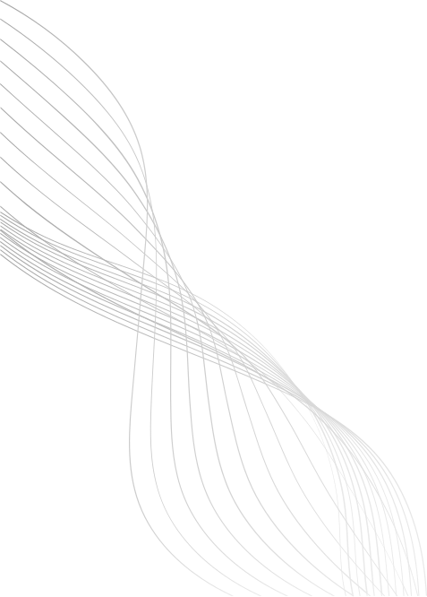

ABOUT ME
STUDENT NAME : Ganta Rajesh
REGISTER NO : 222411455
NMID : 782447E99D454318BDC429B32053F08A
DEPARTMENT : BSC Computer science
COLLEGE : Mangalam College of Arts and Science
Affiliated : University of Madras
01

Slide 3

PROJECT TITLE
Interactive digital portfolio using front end development
02

Slide 4

AGENDA
1.
Problem statement
2.
Project overview
3.
End users
4.
Tools and techniques
5.
Portfolio design and layout
6.
Features and functionality
7.
Results and screenshot
8.
Conclusion
9.
GitHub link
03

Slide 5

PROBLEM STATEMENT
Many students lack a professional space to present their skills and achievements. A digital portfolio enables organized showcasing of academic and technical milestones.
04

Slide 6


PROJECT OVERVIEW
This project is a personal digital portfolio website aimed at enhancing professional presence online. It allows users to display their career highlights, academic background, and certifications in an organized.manner. Built with a focus on responsiveness and user experience, the portfolio serves as a central hub for self-promotion.
Key Features:
About Me: Introduction and background.
Education: Academic history and milestones.
Skills: Technical and soft skills.
Certificates: Achievements and completed courses
Contact: Simple form for communication or queries
05

Slide 7



WHO ARE THE END USERS
•Students.
•teacher.
•Job seekers.
•Freelancers.
•Professionals.
06

Slide 8

TOOLS AND TECHNIQUES
HTML Structure (pages. sections).
CSS Styling (colors. layouts, responsiveness).
JavaScript → Interactivity (mobile navigation Menu toggle)
Mention code editor VS Code (Visual studio) and hosting platform (GitHub Pages)
07

Slide 9
PORTFOLIO DESIGN AND LAYOUT
Home
About Me
Skills
Projects
Achievements
Contact
Responsive navigation with hamburger menu
Responsive layout (mobile ,desktop view)
08

Slide 10

FEATURES AND FUNCTIONALITY
Responsive navigation bar with hamburger menu for mobile view
Skills section displayed using simple list
Certificates section displayed in grid format
Contact details with email,-phone number
Footer copyright
08

Slide 11

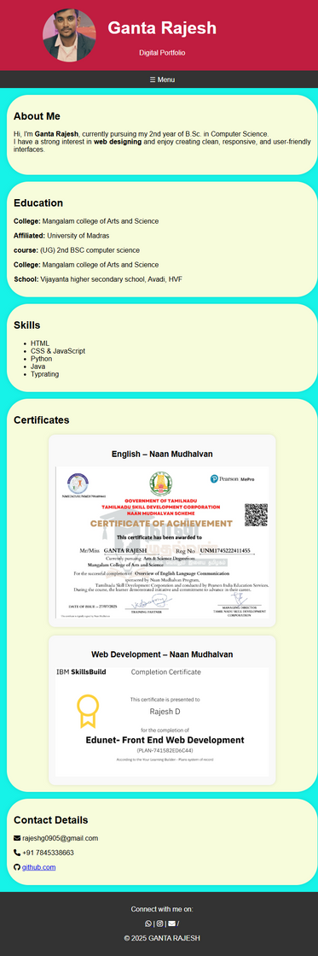
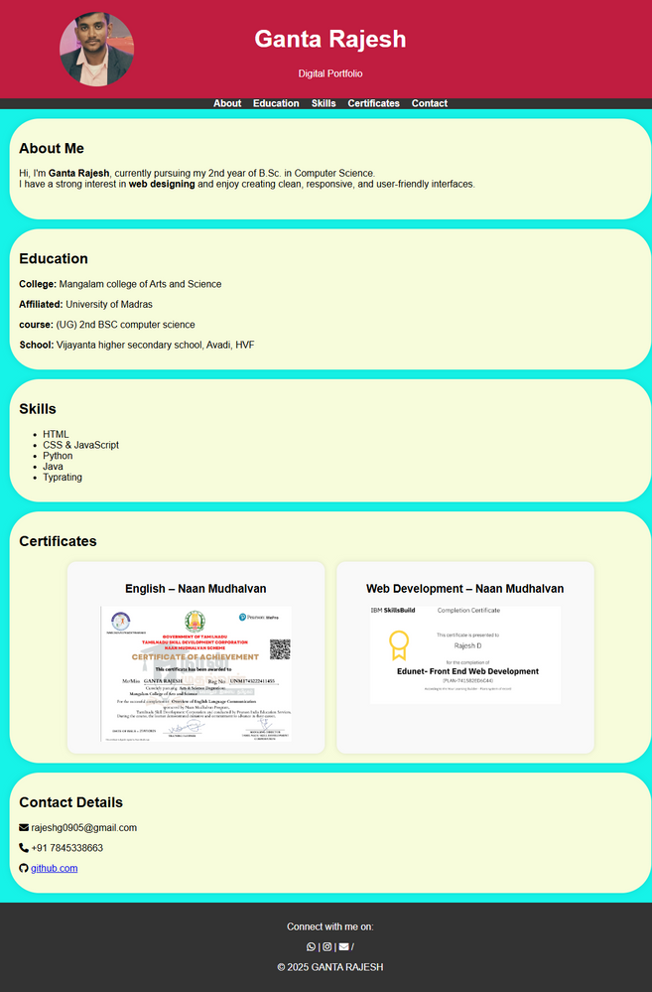
RESULTS AND SCREENSHOTS
Portfolio desktop view
Portfolio mobile view
09

Slide 12
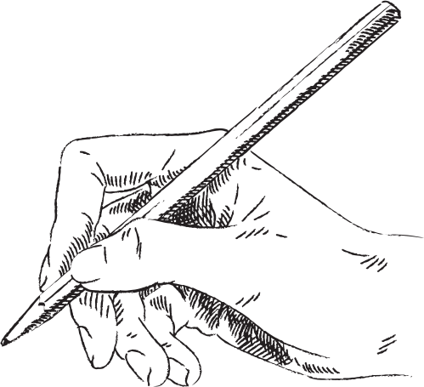

CONCLUSION
This portfolio project highlights my journey as a B.Sc. Computer Science student. It showcases my interests, skills, and projects in a clean, responsive layout. The site is simple, beginner-friendly, and functional across desktop and mobile.
visit my portfolio
https://gantarajesh0905-gr.github.io/NM/
R ajesh
10

Slide 13

THANKING
You
11

